Slide 1
Network Security
Conventional Encryption
Selected slides from
CSC290 Hofstra University and Vitaly Shmatikov University of Texas

Slide 2
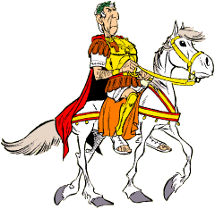
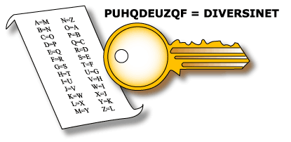
Caesar Cipher
plain: key:
abcdefghijklmnopqrstuvwxyz defghijklmnopqrstuvwxyzabc
cipher: | PHHW | PH | DIWHU | WKH | WRJD | SDUWB
plain: | MEET | ME | AFTER | THE | TOGA | PARTY

Slide 3
Basic Types of Ciphers
Transposition ciphers – rearrange bits or characters in the data
Substitution ciphers – replace bits, characters, or blocks of characters with substitutes

Slide 4
“Rail-Fence” Cipher
DISGRUNTLED EMPLOYEE
D R L E O
I G U T E M L Y E S N D P E
DRLEOIGUTE MLYESNDPE

Slide 5
Encryption Methods
The essential technology underlying virtually all automated network and computer security applications is cryptography
Two fundamental approaches are in use: Conventional Encryption, also known as symmetric encryption
Public-key Encryption, also known as asymmetric encryption

Slide 6
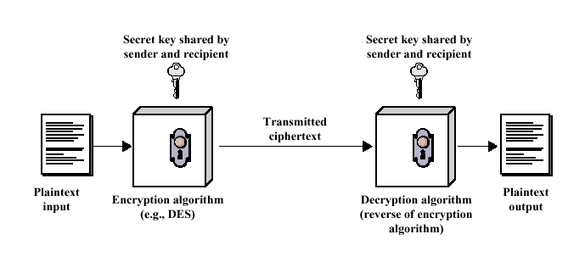
Conventional Encryption Model

Slide 7
Conventional Encryption
The only form of encryption prior to late 1970s Long history
Most widely used

Slide 8
Conventional Encryption
Five components to the algorithm
Plaintext: The original message or data
Encryption algorithm: Performs various substitutions and transformations on the plaintext
Secret key: Input to the encryption algorithm. Substitutions and transformations performed depend on this key
Ciphertext: Scrambled message produced as output. depends on the plaintext and the secret key
Decryption algorithm: Encryption algorithm run in reverse. Uses ciphertext and the secret key to produce the original plaintext

Slide 9
Conventional Encryption
More rigorous definition
Five components to the algorithm
A Plaintext message space, M
A family of enciphering transformations, E_{K}:M → C, where K∈K
A key space, K
A ciphertext message space, C
A family of deciphering transformations, D_{K}: C → M, where K∈K

Slide 10
Conventional Encryption
M E_{K} C D_{K} M
E_{K} defined by an encrypting algorithm E D_{K} defined by an decrypting algorithm D
For given K, D_{K} is the inverse of E_{K}, i.e.,
D_{K}(E_{K}(M))=M
for every plain text message M

Slide 11
Requirements & Weaknesses
Requirements
A strong encryption algorithm
Secure process for sender & receiver to
obtain secret keys
Methods of Attack Cryptanalysis Brute force

Slide 12
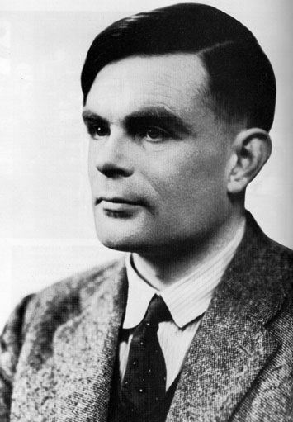
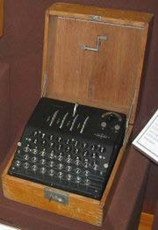
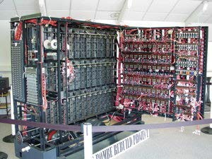
Cryptanalysis
The process of attempting to discover the plaintext or key
Alan Turing broke the Enigma Code in WWII

Slide 13
Cryptanalysis
Security depends on the key...
...NOT the secrecy of the algorithm Low cost chips are possible
Principal security problem is maintaining the secrecy of the key!

Slide 14
Cryptographic Systems
Type of Transformation – substitution and/or transposition; no information must be lost, i.e., reversible
Number of Keys Used – symmetric, single key, conventional; asymmetric, two-key, public-key encryption
Plaintext Processing – block or stream cipher

Slide 15
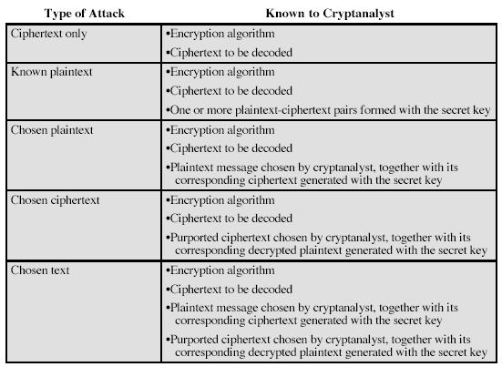
Attacks On Encrypted Msgs

Slide 16
Computationally Secure
Cost of breaking cipher exceeds value of encrypted information
Time to break cipher exceeds useful lifetime of the information

Slide 17
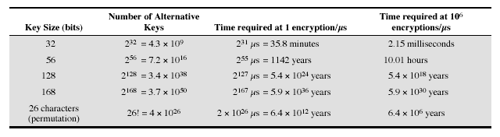
Exhaustive Key Search
Brute Force with massively parallel processors

Slide 18
English Redundancy
Delete vowels and double letters
mst ids cn b xprsd n fwr ltrs, bt th xprnc s mst nplsnt

Slide 19
Simple Cryptanalysis
CIPHERTEXT:
UZQSOVUOHXMOPVGPOZPEVSGZWSZOPFPESXUDBMETSXAIZ VUEPHZHMDZSHZOWSFPAPPDTSVPQUZWYMXUZUHSX EPYEPOPDZSZUFPOMBZWPFUPZHMDJUDTMOHMQ

Slide 20
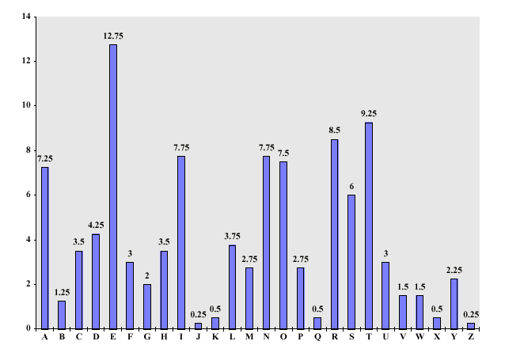
Letter Frequency In the English Language

Slide 21
Simple Cryptanalysis
PLAINTEXT:
IT WAS DISCLOSED YESTERDAY THAT SEVERAL INFORMAL BUT DIRECT CONTACTS HAVE BEEN MADE WITH POLITICAL REPRESENTATIVES OF THE VIET CONG IN MOSCOW

Slide 22
20th Century Encryption
20’s & 30’s bootleggers made heavy use of cryptography
FBI create an office for code-breaking Japanese Purple Machine
German Enigma Machine
Navajo Code Talkers - Windtalkers

Slide 23
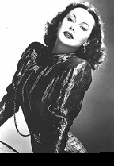
Hedy Lamarr
1941, Lamarr and composer George Antheil received a patent for their invention of a classified communication system that was especially useful for submarines
It was based on radio frequencies changed at irregular periods that were synchronized between the transmitter and receiver
Spread Spectrum – wireless devices

Slide 24
Feistel Cipher Structure
Horst Feistel of IBM, 1973
Input is plaintext block of length 2w bits (usually 64) and a key K
Block is divided into two halves, L₀ and R₀
Each round i has inputs L_{i-1} and R_{i-1}, derived from the previous round, along with subkey K_{i}
Substitution is performed on the left half of the data
Round function F applied to right half and then XOR’d with left

Slide 25
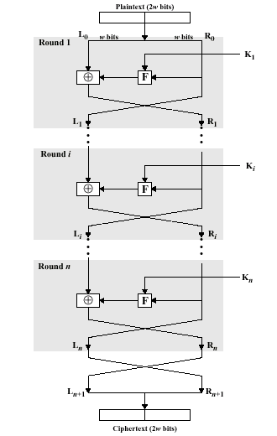
Feistel Cipher Structure
Things to consider:
-Block size (64)
-Key Size (128)
-# of rounds (16)
-SubKey Generation
-Round function

Slide 26
Data Encryption Standard (DES)
Adopted in 1977, reaffirmed for 5 years in 1994, by NBS(NIST)
Plaintext is 64 bits (or blocks of 64 bits), key is 56 bits
Plaintext goes through 16 iterations, each producing an intermediate value that is used in the next iteration
DES is now too easy to crack to be a useful encryption method

Slide 27
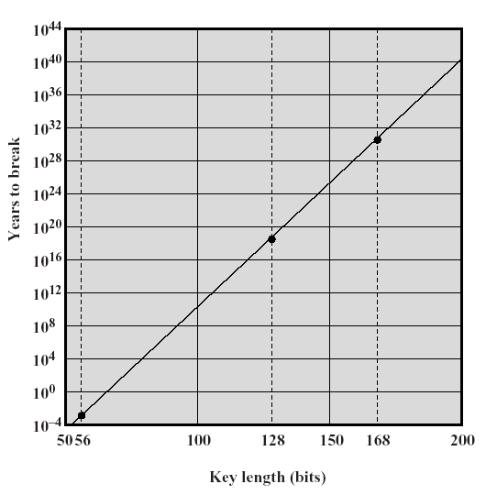
Strength of DES
Concerns about the algorithm itself
Concerns about 56-bit key – this is the biggest worry

Slide 28
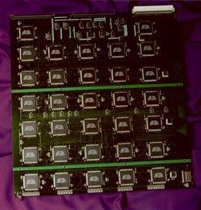
Strength of DES
DES is the most studied encryption algorithm in existence
No one has succeeded in discovering a fatal weakness
1998, DES Cracker from Electronic Frontier Foundation, built for $250,
Solution: Use a bigger key
000

Slide 29
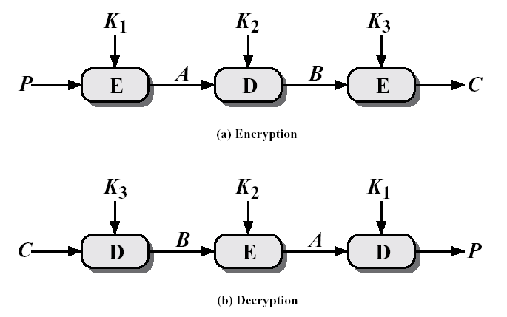
Triple DES
C = E_{K3} [D_{K2} [E_{K1} [P ]]]

Slide 30
Triple DES
Alternative to DES, uses multiple encryption with DES and multiple keys
With three distinct keys, 3DES has an effective key length of 168 bits, so it is essentially immune to brute force attacks
Backward compatible with DES Principal drawback of DES is that the
algorithm is relatively sluggish in software

Slide 31
Advanced Encryption Standard
NIST call for proposals in 1997 Nov, 2001 – Rijndael [rain´ dow]
Symmetric block cipher (128 bits) and key lengths 128, 192, 256
Two Flemish cryptographers: Joan Daeman and Vincent Rijmen

Slide 32
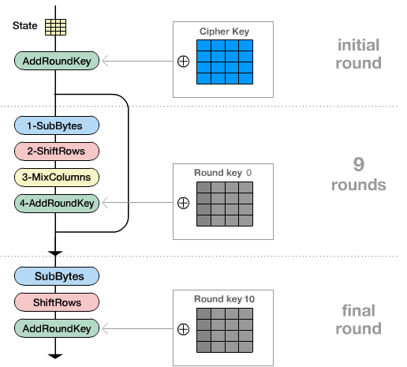
Overview of AES
4Transformations: Substitute Bytes Shift Rows
Mix Columns Add Round Key

Slide 33
AES URLS
http://csrc.nist.gov/CryptoToolkit/aes/rijndael/ - NIST AES
http://www.esat.kuleuven.ac.be/~rijmen/rijndael
/ - Rijndael Home Page
http://www.esat.kuleuven.ac.be/~rijmen/rijndael
/Rijndael_Anim.zip - Great Animation

Slide 34
IDEA
International Data Encryption Algorithm
1991 by Swiss Federal Institute of Technology
Uses 128-bit key
Complex functions replace S-boxes Highly resistant to cryptanalysis Used in PGP

Slide 35
Blowfish
1993 by Bruce Schneier
Easy to implement; high execution speed
Variable key length up to 448 bits
Used in a number of commercial applications

Slide 36
RC5
1994 by Ron Rivest, one of the inventors of RSA algorithm
Defined in RFC2040
Suitable for hardware and software
Simple, fast, variable length key, low memory requirements
High security

Slide 37
CAST-128
1997, Entrust Technologies
RFC 2144
Extensively reviewed
Variable key length, 40-128 bits Used in PGP

Slide 38
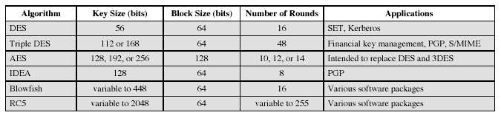
Conventional Encryption Algorithms

Slide 39
Encrypting a Large Message
So, we’ve got a good block cipher, but our plaintext is larger than 128-bit block size
Electronic Code Book (ECB) mode
Split plaintext into blocks, encrypt each one separately using the block cipher
Cipher Block Chaining (CBC) mode
Split plaintext into blocks, XOR each block with the result of encrypting previous blocks
Also various counter modes, feedback modes, etc.

Slide 40

ECB Mode
plaintext
block cipher
block cipher
block cipher
block cipher
block cipher
ciphertext
Identical blocks of plaintext produce identical blocks of ciphertext
No integrity checks: can mix and match blocks

Slide 41

CBC Mode: Encryption
plaintext
Initialization vector (random)
⊕
⊕ ⊕
⊕
block cipher
block cipher
block cipher
block cipher
Sent with ciphertext (preferably encrypted)
ciphertext
Identical blocks of plaintext encrypted differently
Last cipherblock depends on entire plaintext

Slide 42
CBC Mode: Decryption
plaintext
Initialization vector
⊕
⊕ ⊕
decrypt decrypt
⊕
decrypt
decrypt
ciphertext

Slide 43
Cipher Block Chaining Mode
Input to algorithm is the XOR of current plaintext block and preceding ciphertext block
Repeating patterns are not exposed
43

Slide 44
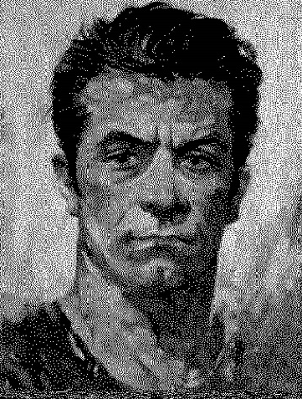


ECB vs. CBC (due to Bart Preneel)
AES in ECB mode
AES in CBC mode
Similar plaintext blocks produce similar ciphertext blocks (not good!)

Slide 45
Location of Encryption Devices
Link Encryption
Each vulnerable communications link is equipped on both ends with an encryption device
All traffic over all communications links is secured
Vulnerable at each switch

Slide 46
Location of Encryption Devices
End-to-end Encryption
The encryption process is carried out at the two end systems
Encrypted data are transmitted unaltered across the network to the destination, which shares a key with the source to decrypt the data
Packet headers cannot be secured

Slide 47
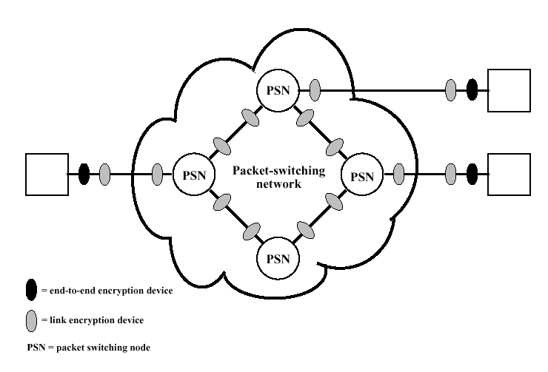
Location of Encryption Devices

Slide 48
Key Distribution
Both parties must have the secret key
Key is changed frequently
Requires either manual delivery of keys, or a third-party encrypted channel
Most effective method is a Key Distribution Center (e.g. Kerberos)

Slide 49
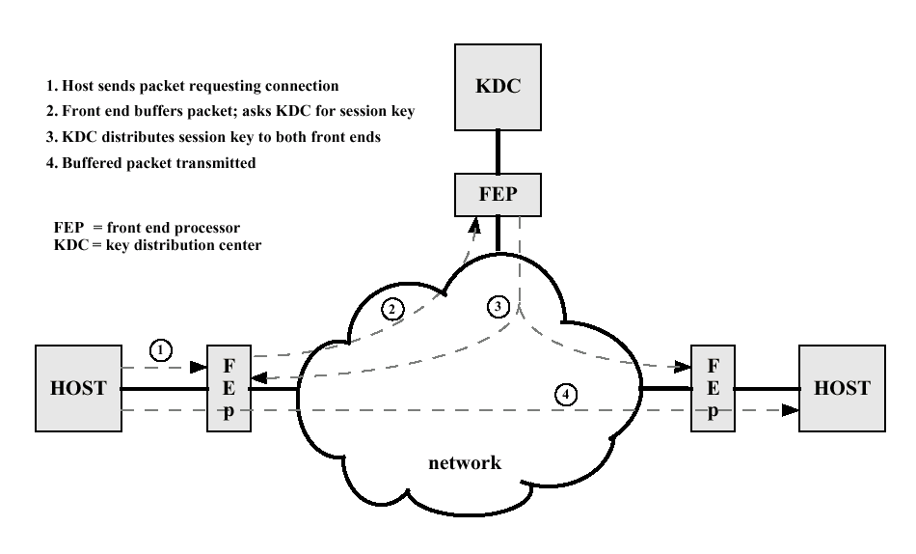
Key Distribution

